Slide 1
High-Energy Fires: Concerns & Protections
Triennial International Aircraft Fire and Cabin Safety Research Conference
October 29, 2019
Retired Capt. Boomer Bombardi
Capt. Scott Schwartz, Director, Dangerous Goods
Air Line Pilots Association, Int’l

Slide 2
Overview
Past Accidents
High Energy Fire Work
Specific Concerns in the Flight Deck
Tools to Mitigate the Hazard
Conclusion

Slide 3
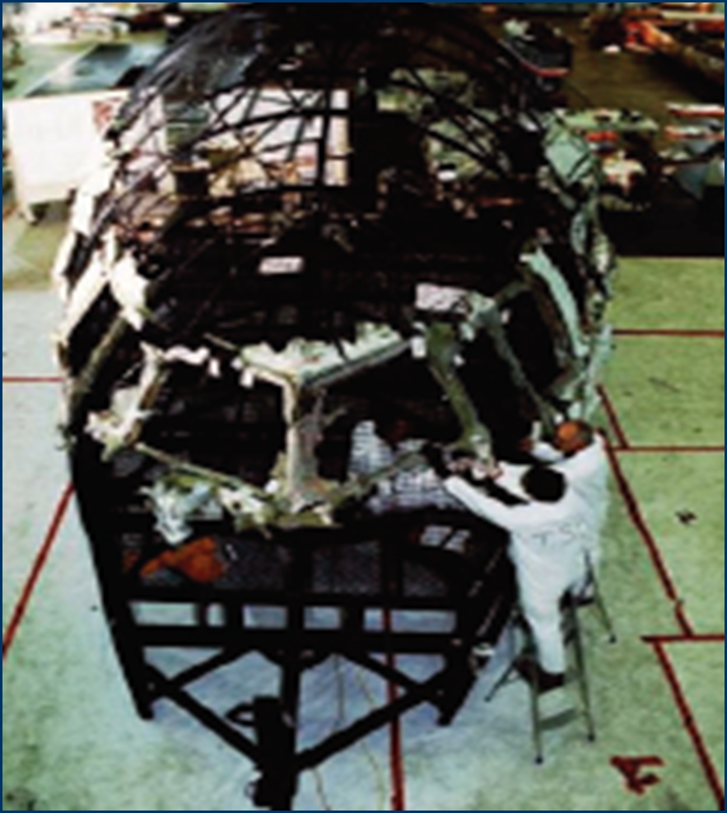
Swissair 111

Slide 4
Air Canada 797

Slide 5
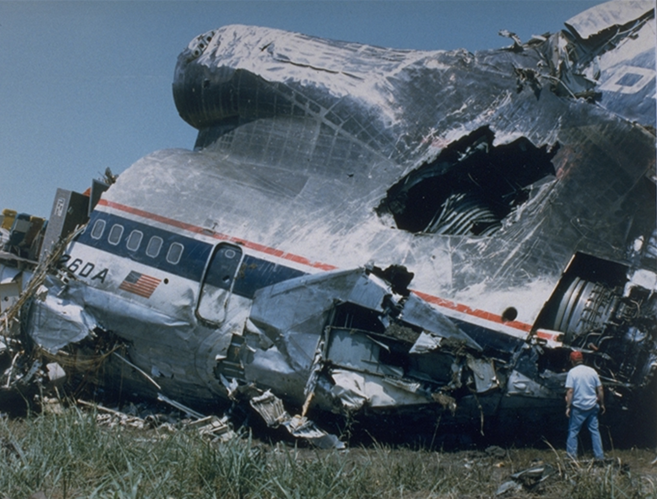
Delta 191
Air Canada 797

Slide 6
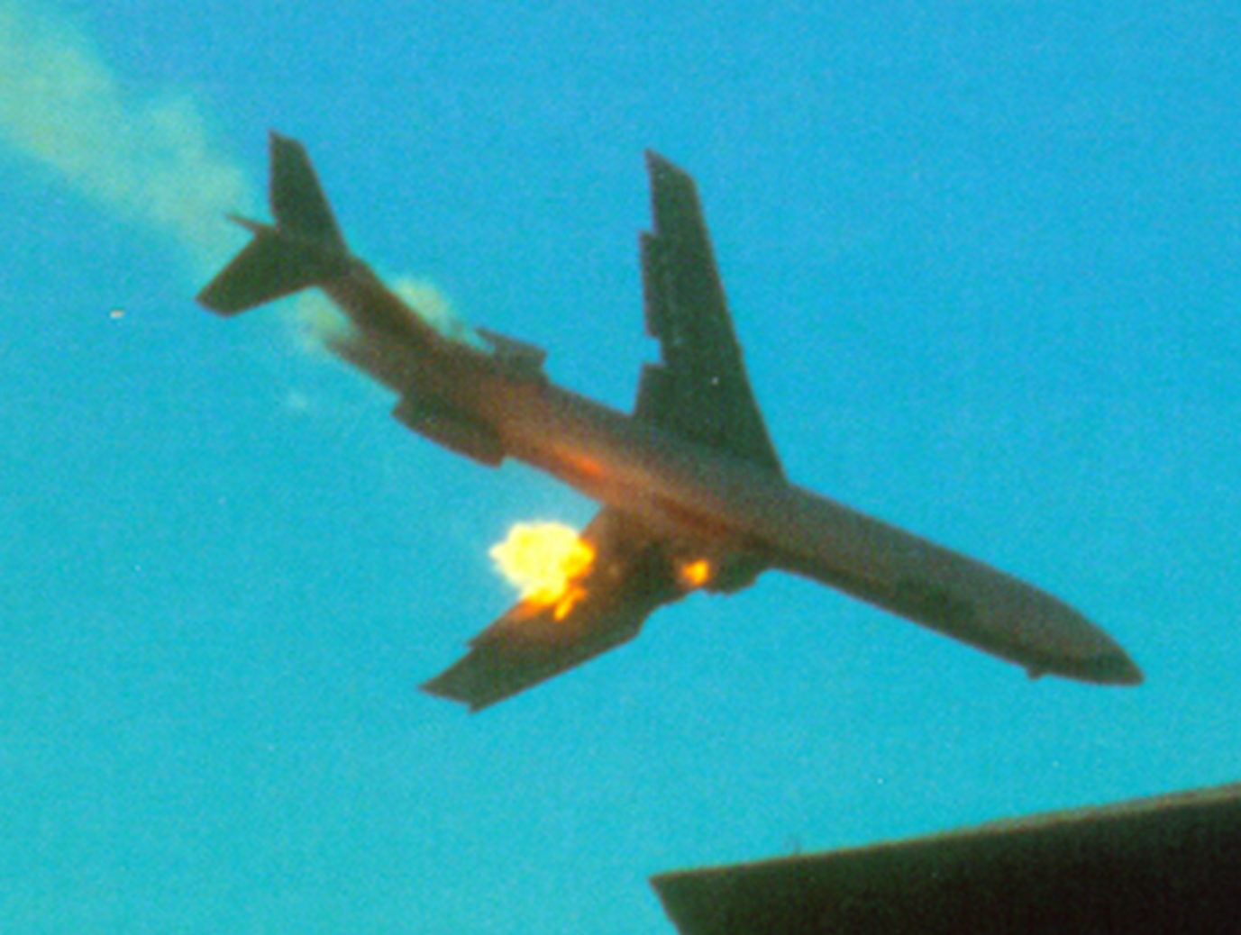
PSA 182

Slide 7
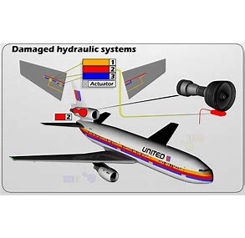
United 232

Slide 8
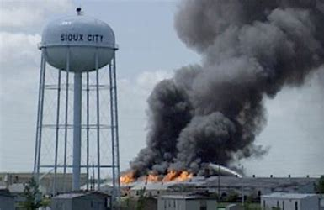
United 232

Slide 9
ALPA Research and Work Continues
Notes:
Everything has always been predicated that the fire was starting in the back, not now. So we have started this discussion.

Slide 10
HEFTE WG Overview
High Energy Fire Training Enhancement WG
Tasked Aug 2017 – Recommendations Nov. 2018
Assumption that each passenger is carrying between 2-3 lithium ion devices per flight
Pilots & Flight Attendants now have EFBs
Notes:
As part of a tasking from the Air Carrier Training Aviation Rulemaking Committee (ACT ARC)
There were 11 members: 3 Industry SME, 2 FAA SME, 1 support
One F2F – February 2018 at FAA Tech Center in Atlantic City, NJ
According to the FAA Air Traffic Organization, there are around 2.5 million airline passengers per day across the US airspace. If you assume somewhere between 2-3 lithium ion devices carried by each passenger (for calculation purposes we used 2.5 PEDs per person), this translates to approximately 2.3 billion lithium ion battery powered devices brought into the aircraft cabin per year just in the USA.

Slide 11
HEFTE WG Scope & Recommendations
Recommend updates/improvements to current training & guidance around response to high-energy fires (HEF) that can occur in occupied areas of the aircraft.
General firefighting the same except way HEF can start, propagate & ways to extinguish
Recommendation 18.5 – online at FAA.gov
Seven main recommendations with multiple sub-recommendations
Notes:
https://www.faa.gov/about/office_org/headquarters_offices/avs/offices/afx/afs/afs200/afs280/act_arc/act_arc_reco/media/2018/ACT_ARC_Rec_18-5.pdf
Suggest they go online to review the document.
General firefighting philosophy == LOCATE fire source, FIGHT the fire, MOVE PAX away from area, COORDINATE actions with crew, MONITOR for re-ignition, REPORT the event.

Slide 12
HEFTE WG Recommendations
Recognize early warning signs of battery fires
Emphasize the intensity of HEF
Smoke and fume concerns
Revised training scenarios
Installed products should have hands-on training
Develop product performance standards
Research need to update current testing protocols
Notes:
Rainbow on screen – on device
Firefighting in the cockpit is very different
All these recommendations work --- but they can look very different in the flightdeck. Therefore even more information is needed when we start addressing these issues.

Slide 13
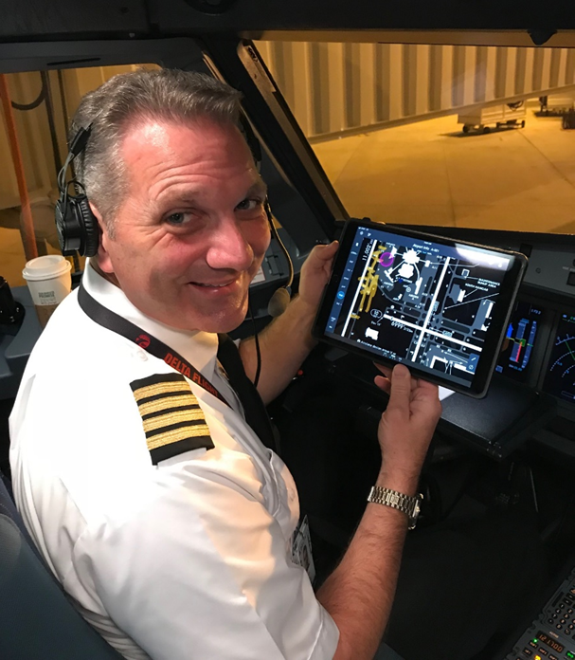
Smoke in the Flightdeck
Electronic Flight Bags (EFB) more prevalent now
It is the Air Line Pilots Association, International (ALPA) position that EFBs are an integral part of safety and support their continued use, including in the flightdeck
Notes:
We get important information from these devices.
But the potential for a hazard means we need a closer look.

Slide 14
A Closer Look
Containing/controlling the event
Fire – Heat - Projectiles
Smoke generation in the flightdeck
Procedures to clear the volume of smoke
Maintain aircraft control (Protective Equipment)
Containment Products (and/or extinguishment?)
Notes:
This is an OVERVIEW slide of discussion to come!!!
These bullets lead to other slides following…
The situation in the flightdeck is completely different.

Slide 15
Protect, Contain and Control
Aviate – Navigate – Communicate
Protect the flightcrew
Move or not to move
The device location – mounted or not
Isolate and Extinguish

Slide 16
Research & Testing to Clear the Smoke
Guidance needs updating
Defined amount of smoke versus continuous smoke generation
Density and volume
From occupied areas into the flightdeck
Cabin & Flightdeck have different designs in ventilation and volume
Different mitigation
Notes:
Continuous generation of single puff of smoke.
FAA regulations and guidance (for example, AC 25-9A, Smoke Detection, Penetration, and Evacuation Tests and Related Flight Manual Emergency Procedures) set standards for testing the ability to detect smoke, demonstrating that smoke will not penetrate occupied compartments, and demonstrating that smoke in the flightdeck can be readily evacuated. Specific to smoke evacuation in the flightdeck, AC 25-9A indicates that the smoke should be reduced within 3 minutes to ensure no interference with flight operations. AC 25-9A has not been revised since January 1994 and may not adequately reflect current concerns with respect to HEFs and their associated smoke conditions. If too much smoke is generated or if the smoke cannot be adequately removed from the flightdeck, the pilots may be unable to see their flight instruments, inhibiting their ability to safely fly and land the aircraft.

Slide 17
Testing for Smoke in the Flightdeck
The FAA Tech Center should conduct further lithium battery thermal runaway testing in one of its test aircraft or flight deck mockups
New smoke characteristics - testing must demonstrate that smoke can be cleared
Pilots must be able to see the instruments and outside the airplane for landing
Notes:
Use of PBE (toxicity) or other equipment
Use of vision enhancing devices

Slide 18
Containment Products
Research to develop a definitive performance standard for “containment” products, including addressing release of toxic fumes or flammable gases
Now we rely on vendors for product facts
Clarify the intent of use –
extinguish a burning device, or
contain an extinguished device?
UL work on the subject
Notes:
readily accessible

Slide 19
Conclusion
Working together we can address this emerging threat:
Updating the guidance and training material
Developing performance standards for products
Ensuring adequate equipment onboard to fight the threat
Updating design standards to mitigate smoke, fumes and noxious gases out of the flightdeck

Slide 20
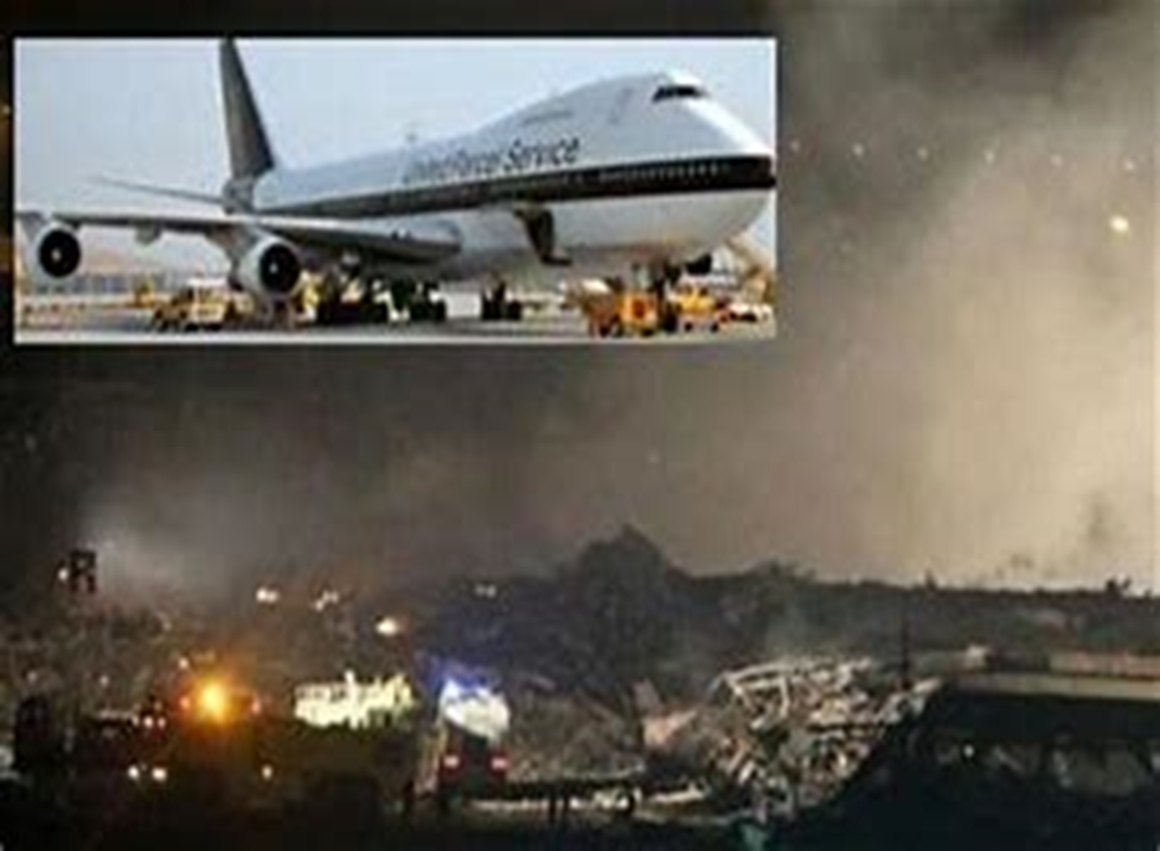

Slide 21
QUESTIONS?

